Slide 1
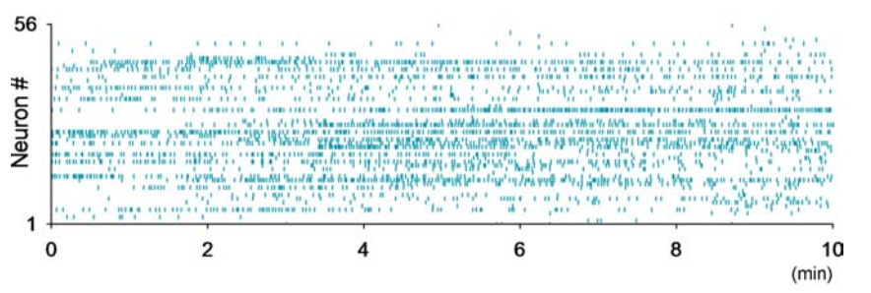
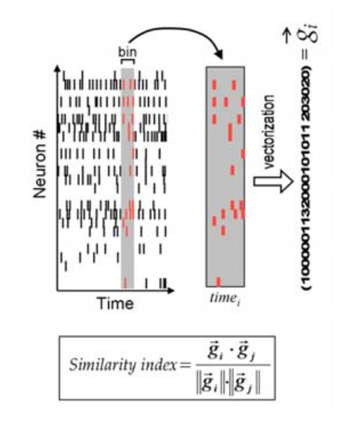
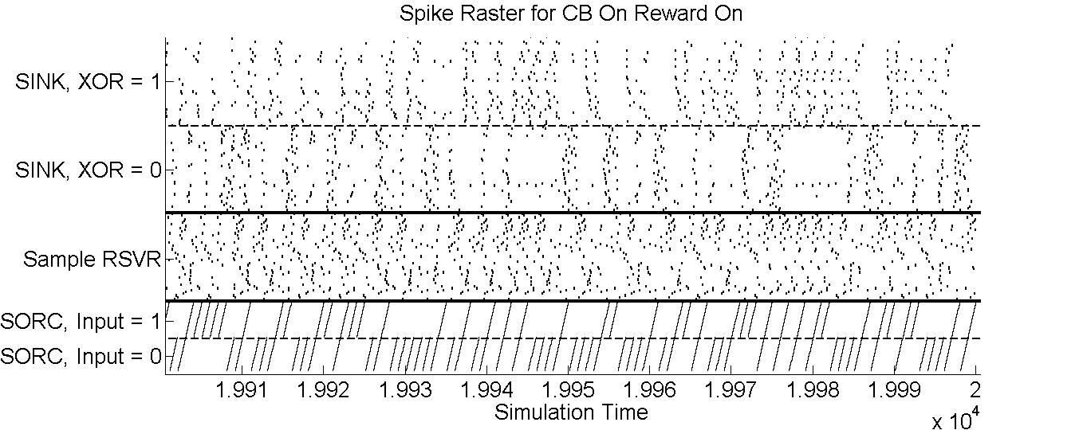
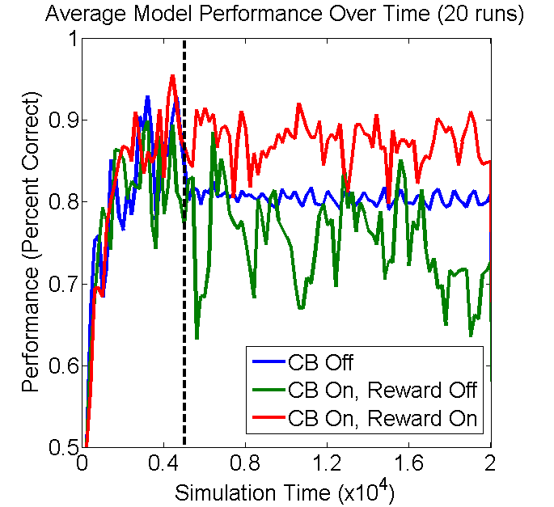
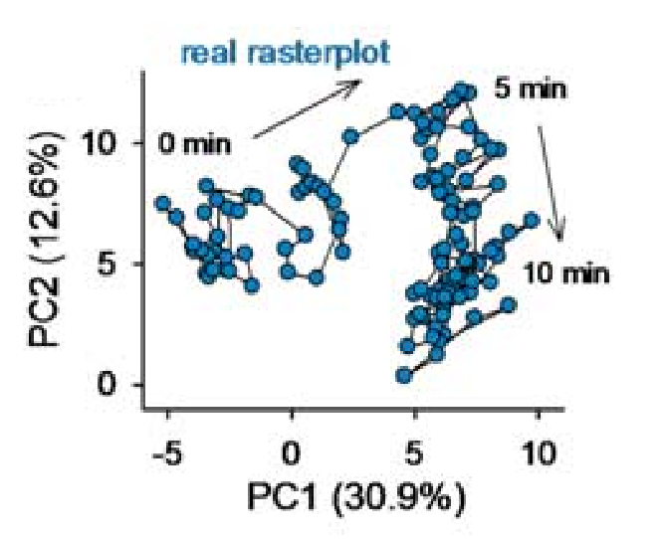
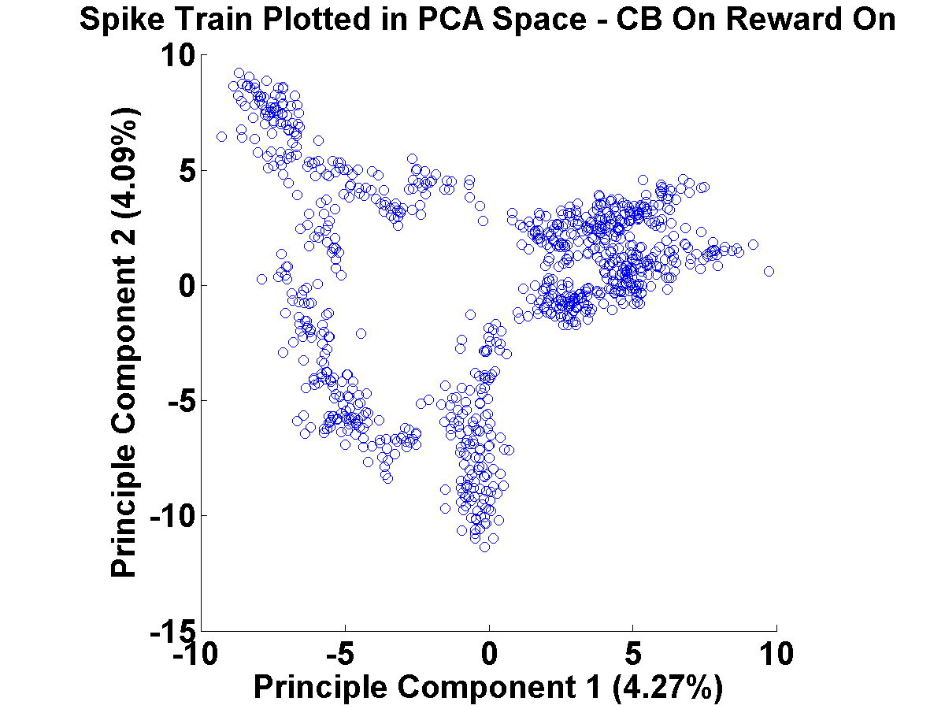
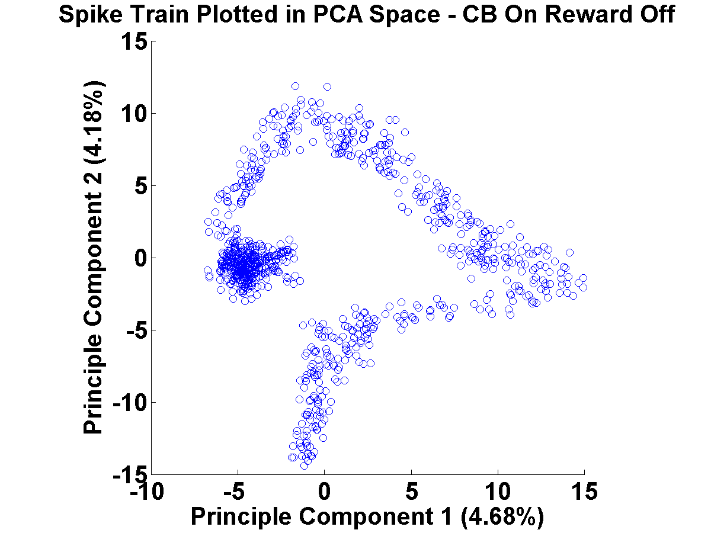
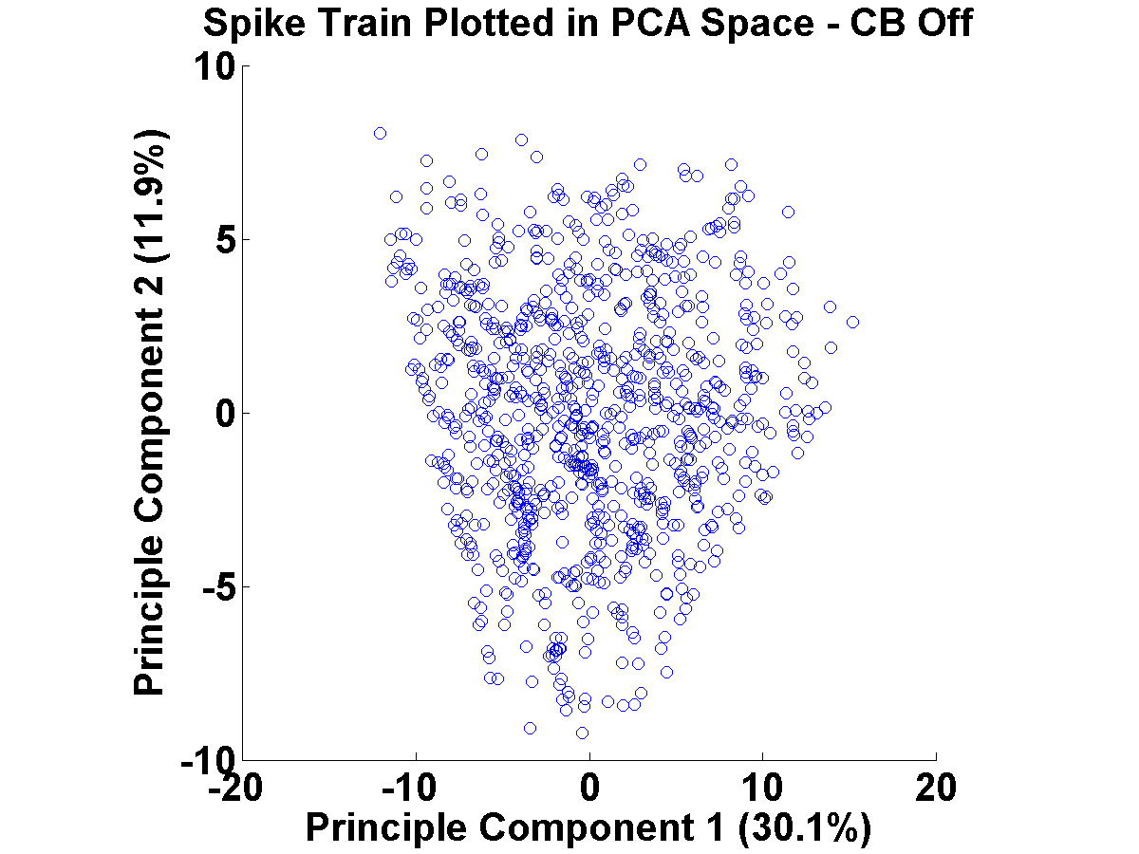
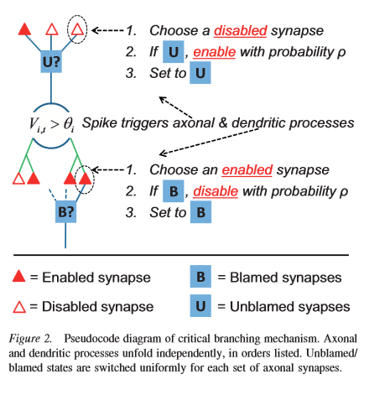
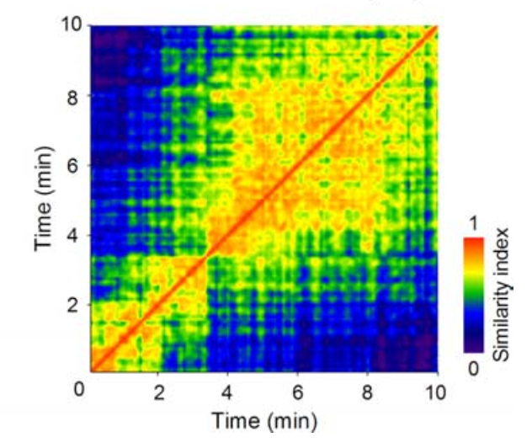
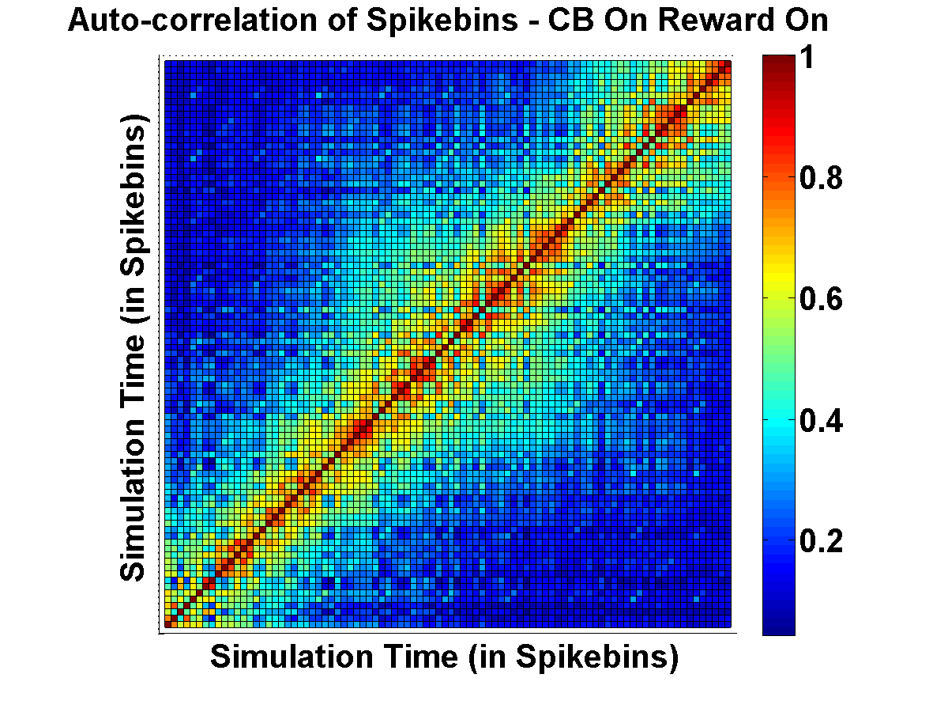
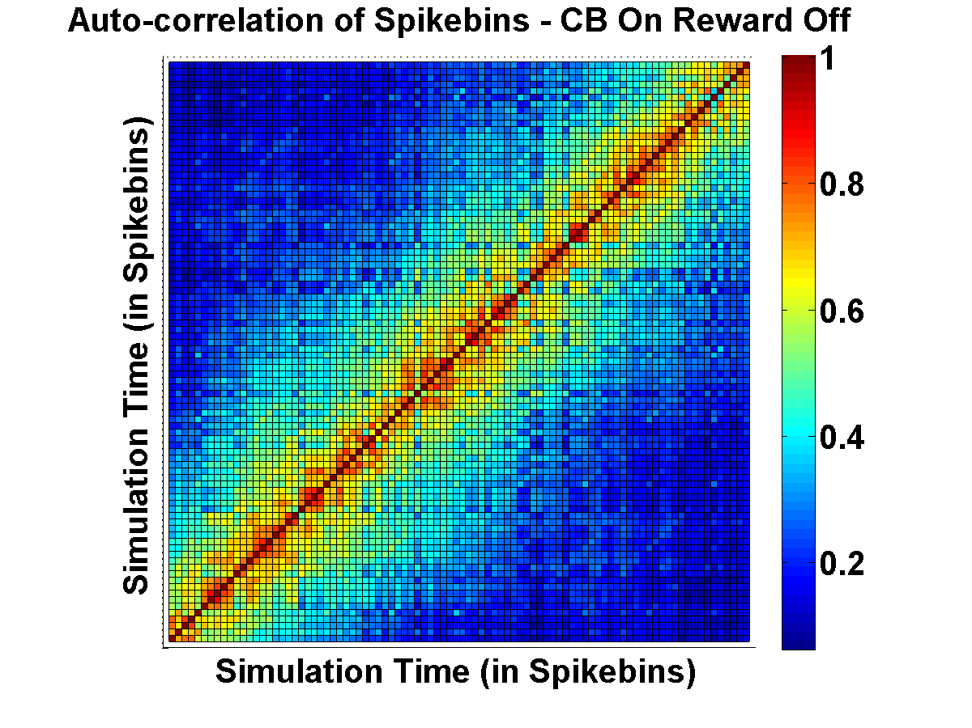
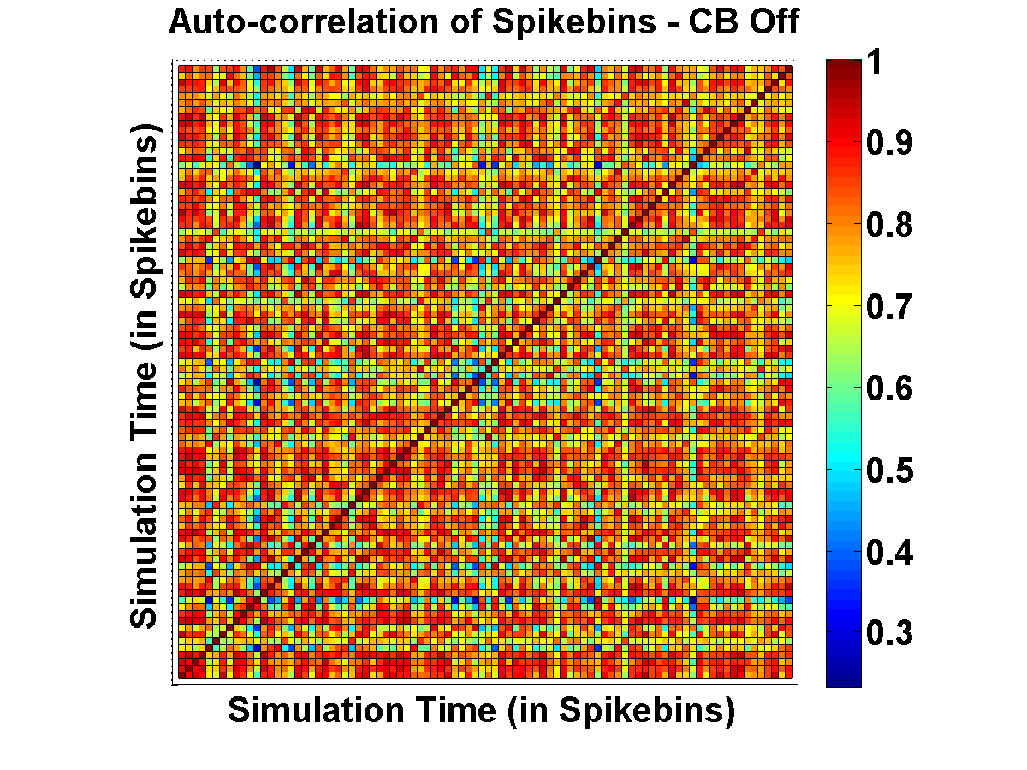
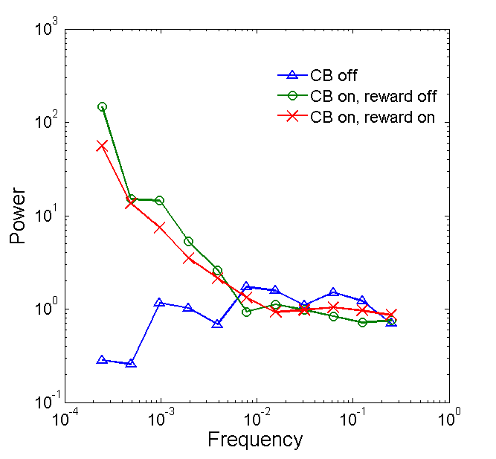
Self‐Tuning to Reward and the Edge of Chaos
Jeffrey J. Rodny, and Christopher T. Kello
Cognitive and Information Sciences,
University of California, Merced
Objective
Results – Spike Raster Plots and Analysis Methods
Analyze an algorithm that combines learning with self-regulation of spike activity.
Measure the metastability of a critical branching network that exhibits stable learning of a nonlinear function.
(Sasaki et. al, 2007)
(Sasaki et. al, 2007)
Neural Spiking Model
Results – Stable Learning
SINK
(100 units)
Target( t ) = XOR( t - 3, t - 4 )
XOR( 1, 0 ) = 1
RESERVOIR
(3000 units)
SOURCE
(40 units)
Figure 1: A. Diagram of the model. Connections are randomly made at a 10% chance for each unit pair at each arrow.
Input bits presented as spatio-temporal spike patterns
Network dynamics have fading memory and nonlinear separation
Synapses are enabled and disabled to self tune towards critical branching
Critical branching implements edge of chaos “computation”
Metastability Results – Model Comparison with CA3 Neural Data from Sasaki et. al. (2007)
Learning Algorithm
(Sasaki et. al, 2007)
Figure 2: A diagram of the critical branching algorithm (from Kello, 2013). The novel addition (not shown here) is tracking correlation of each unit’s spikes with reward value on sink units.
(Sasaki et. al, 2007)
Further Metastability Results
Conclusions
References
Learning algorithm sets choice of which synapse to enable and disable
Sink units have a reward trace that tracks running average of correlation with reward
Synapses enabled for units with positive correlation and disabled for units with negative correlation
When no positive reward traces available to enable, choose randomly
Fundamental challenge is robustly learning a nonlinear function while maintaining metastable heterogeneous spiking.
Here the model exhibits nonstationary statespace movement while maintaining stable, long term learning.
References:
Kello, C. T. (2013). Critical branching neural networks. Psychological review, 120(1), 230.
Sasaki, T., Matsuki, N., & Ikegaya, Y. (2007). Metastability of active CA3 networks. The Journal of neuroscience, 27(3), 517-528.
Acknowledgements:
The authors would like to thank the Cognitive and Information Sciences department at the University of California, Merced for their insightful comments and feedback, as well as for funding this research.
Cognitive and Information Sciences Department – University of California, Merced Contact: jrodny@ucmerced.edu SCSCS 2013, 3rd Meeting for the Society for Complex Systems in Cognitive Science - Berlin, Germany - July 30, 2013

